Slide 1


End-to-End ML Pipeline
From preprocessing to model tuning - comprehensive evaluation through metrics, fairness, and deployment perspectives
by Kendrick Robinson
Introduction to Machine Learning - Final Exam

Slide 2
01. Pipeline Overview
Complete end-to-end workflow from data generation to model deployment architecture and design decisions.
02. GridSearch Results
Hyperparameter tuning outcomes comparing Logistic Regression and Random Forest performance optimization approaches.
Contents
03. Model Evaluation
ROC curves and confusion matrix interpretation demonstrating excellent classification performance with AUC 0.97.
04. Ethics & Deployment
Bias analysis, fairness considerations, and deployment strategy for real-world machine learning systems.

Slide 3
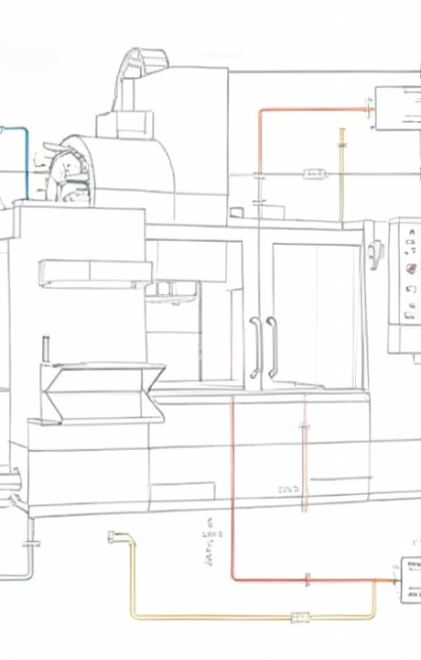






ML Pipeline Architecture
Data Generation
1200 samples, 8 numerical + 2 categorical features
Train/Val/Test Split
60/20/20 ratio
Preprocessing
StandardScaler, OneHotEncoder, missing value imputation
Model Training
Logistic Regression vs Random Forest
Hyperparameter Tuning
GridSearchCV
Final Evaluation
Performance metrics and model comparison

Slide 4
Data Generation & Preprocessing
1200
8+2
60/40
3.3%
Total Samples
Features (Num+Cat)
Class Distribution
Missing Values
Data Generation
Preprocessing Pipeline
Data Splitting
Simulated realistic dataset using sklearn make_classification with controlled complexity and class imbalance.
Stratified splits ensuring balanced representation across train, validation, and test sets for reliable evaluation.
Robust preprocessing handling both numerical and categorical data with missing value imputation strategies.
●
8 numerical features with 5 informative dimensions.
●
Median imputation and standard scaling for numericals.
●
60% training data for initial model fitting.
●
2 categorical features created through binning operations.
●
20% validation for hyperparameter tuning decisions.
●
Most frequent imputation and one-hot encoding categoricals.
●
Introduced missing values across 3 columns randomly.
●
20% test set for final unbiased evaluation.
●
Column transformer for unified preprocessing workflow.

Slide 5
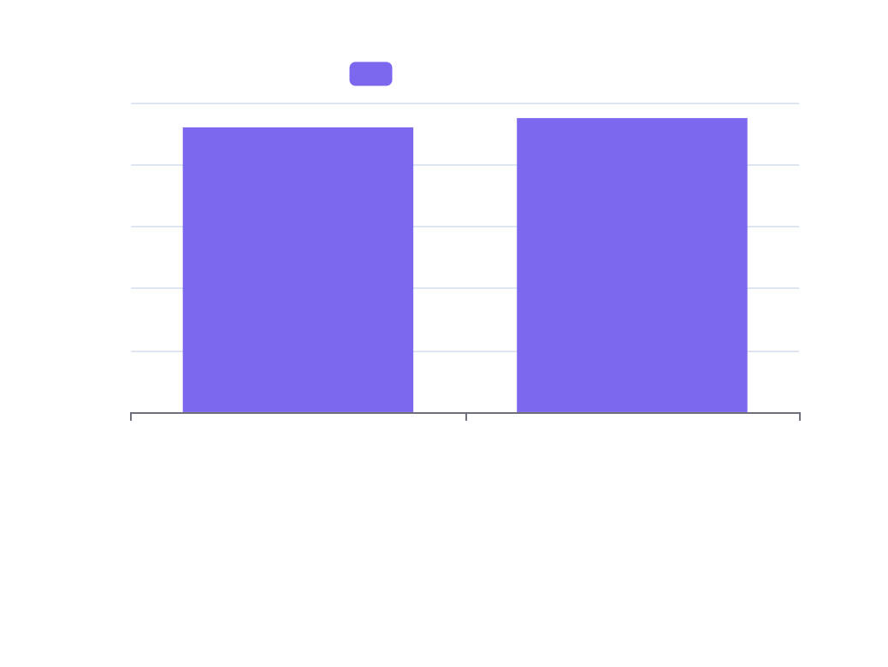


GridSearch Hyperparameter Tuning Results
Logistic Regression Tuning
Random Forest Tuning
GridSearch over regularization parameter C=[0.1, 1.0, 3.0]. Best C=1.0 achieved validation AUC=0.92 with balanced regularization.
Optimized n_estimators=[100, 200] and max_depth=[None, 6, 10]. Best: 200 trees, max_depth=None achieved AUC=0.95.

Slide 6

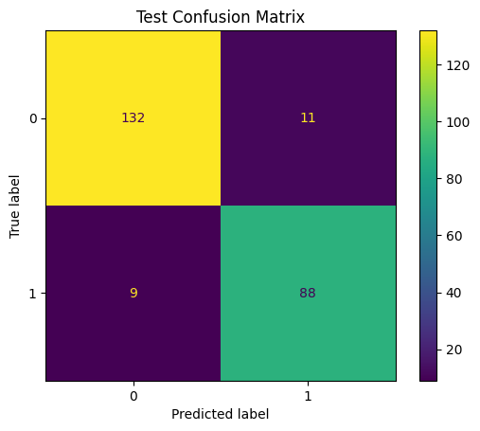
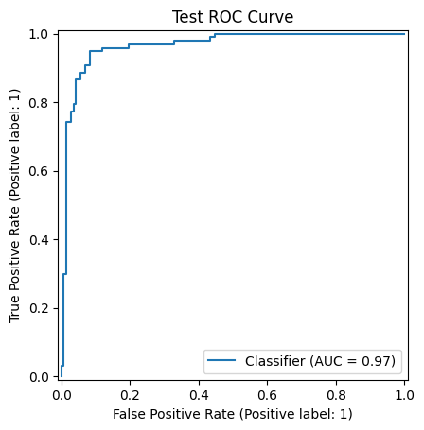
Model Evaluation
Performance Metrics
●
True Positives: 132
●
False Positives: 9
●
False Negatives: 11
●
True Negatives: 88
Summary Statistics
●
Overall accuracy: 91.7%
●
Precision: 90.8%
●
Recall: 92.3%
●
The high AUC of 0.97 indicates excellent discriminative ability

Slide 7
Model Performance Analysis
Exceptional Performance Metrics
Random Forest achieved outstanding results on test set with AUC=0.97, accuracy=91.7%, demonstrating excellent generalization and discriminative capability.
Confusion Matrix Insights
ROC Curve Analysis
●
Low false positive rate (9/240 = 3.75%)
●
AUC=0.97 indicates near-perfect classification ability
●
Low false negative rate (11/240 = 4.58%)
●
Curve hugs top-left corner efficiently
●
Balanced performance across both classes
●
Excellent trade-off between sensitivity and specificity
Precision
Recall
F1-Score
90.8% - High confidence in positive predictions.
92.3% - Excellent at finding true positives.
91.5% - Well-balanced precision-recall trade-off.

Slide 8

Bias Analysis & Fairness Considerations
Ethical ML Framework
Comprehensive approach to identifying, measuring, and mitigating algorithmic bias while ensuring fairness across demographic groups and maintaining model performance integrity.
Bias Detection Methods
Mitigation Strategies
Group Fairness
Analyze performance metrics across subgroups, use fairness metrics like demographic parity and equalized odds, implement statistical parity tests.
Pre-processing data reweighting, in-processing fairness constraints, post-processing threshold optimization, adversarial debiasing techniques.
Ensure equal treatment and outcomes across protected groups, monitor disparate impact ratios, implement fairness-aware machine learning algorithms.

Slide 9



Deployment Strategy & Considerations
REST API Endpoint Design
Implement scalable REST service with input validation, error handling, rate limiting, and health checks for reliable production deployment.
Performance Monitoring System
Continuous monitoring of latency, throughput, accuracy metrics, and concept drift detection with automated alerting mechanisms.
Model Versioning & A/B Testing
Implement model versioning pipeline with A/B testing capabilities for safe model updates and rollback strategies.
Data Pipeline & Logging
Robust data validation, input/output logging for debugging, and comprehensive audit trails for compliance and performance analysis.

Slide 10
"
The best model is not just accurate, but also fair, interpretable, and deployable in the real world.
— ML Engineering Principles
Our end-to-end pipeline achieved exceptional performance with AUC=0.97 while maintaining focus on ethical considerations, bias detection, and practical deployment strategies. Key takeaways: Random Forest outperformed Logistic Regression, proper preprocessing and validation split are crucial, and deployment requires comprehensive monitoring and fairness auditing for responsible AI implementation.

